Slide 1
North Lincolnshire CCG
Quality Strategy
2019 to 2024
1

Slide 2
Content
Executive Summary
CCG Strategy for 2019-2024
Quality – Strategic Context
Strategic Quality Objectives
Quality Strategy Plan on a Page
CCG Strategic Quality Objectives Outcomes and Results:
  Safe and Effective Care.
  Quality in New Models of Care and Commissioning.
  Quality Improvement and Assurance Framework.
  Public and Patient Involvement and Engagement.
  Data and Intelligence.
CCG Delivery Programmes – Quality outcomes plans of a page
  Prevention.
  Primary Care.
  Children and Maternity.
  Out of Hospital Care.
  Hospital Care.
  Mental Health and Learning Disabilities.
8. CCG Quality Strategy 2019 – 2024 Governance Structure
2
Notes:
What does the current Quality Strategy tell us?
What approach does it take?
Has it been effective?
Need a refresh!!

Slide 3
Executive Summary
The CCG Strategy 2019 – 2024 was approved at the Governing Body on 11th April 2019,
and quality is a key enabler of the CCG Strategy.
This Quality Strategy was developed through interactive workshops with members of the CCG Quality Performance and Finance Committee, the Governing Body and Delivery Programme Leads. Feedback provided through these workshops has been used to develop this strategy.
This strategy sets out our vision, objectives and outcomes for quality in the CCG. The CCG has identified a vision for quality that is The Quality of all services that are commissioned for the people of North Lincolnshire are outstanding or good.
Through consultation with stakeholders, five Strategic Quality Objectives have been developed, and each objective is underpinned by a number of result and outcome areas for quality. Our vision and objectives reflect a changing context where we will:
Target improvement for our least represented population;
Agree an approach to improving and assuring quality;
Scan the horizon to identify emerging issues;
Focus on least heard groups;
Utilise intelligence and data from across the place.
To ensure that Quality is embedded in and supports the delivery of the CCG Strategy, each of the CCG Delivery Programmes have identified result and outcome areas for quality. Through delivering these outcomes the CCG will effectively deliver the Strategic Quality Objectives that are defined in this strategy. In delivering our Quality Strategy, we will implement quality improvement across North Lincolnshire at pace and scale, to support a healthier future for our population.
3

Slide 4
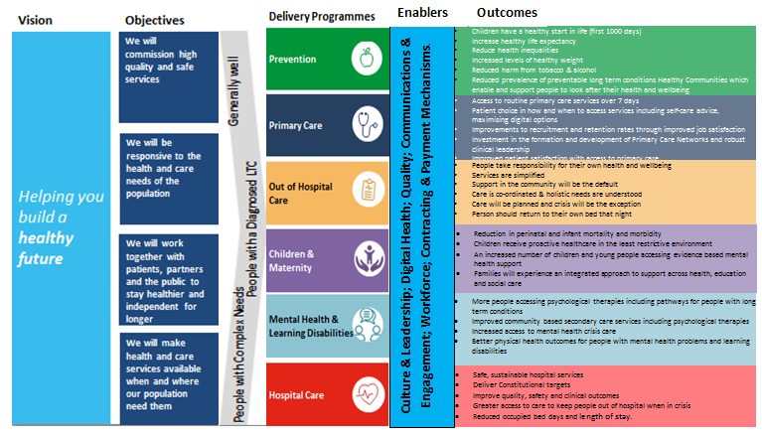
2. CCG Strategy for 2019-2024
Quality is a key enabler of the CCG Strategy 2019-2024.
Quality underpins each of the CCG Delivery Programmes.
DRAFT
6

Slide 5
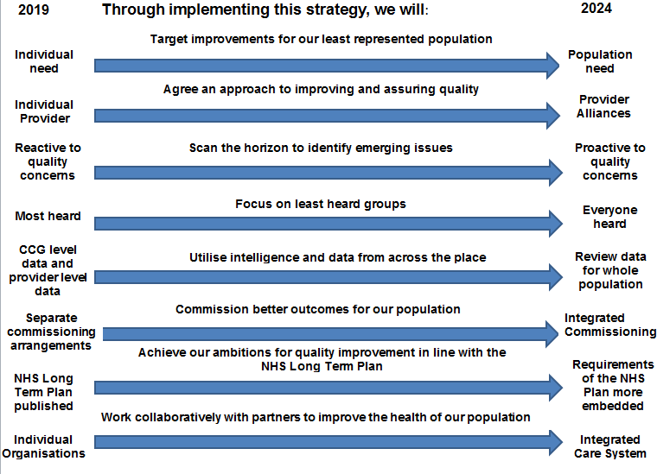
3. Quality – Strategic Context
DRAFT
7

Slide 6
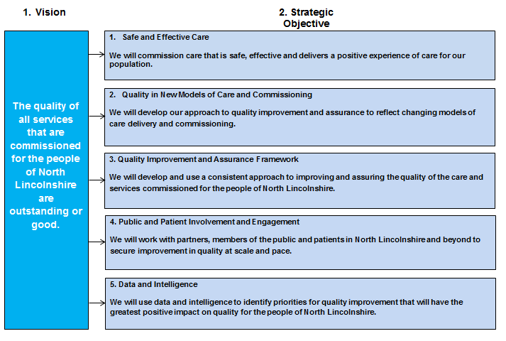
4. Strategic Quality Objectives
DRAFT
8

Slide 7
5. Quality Strategy Plan on a Page
Vision
Strategic Objective
Outcomes and Results
Arrangements for monitoring the safety, effectiveness and experience of care are embedded in service specifications, and are mapped to the six CCG Delivery Programmes and to provider contracts.
Achievement of constitutional targets, reduction in pressure ulcers, all serious incidents associated with long waits for care and mortality rates.
Increase in healthy life years.
Patient outcomes are focused on the needs of the population and health inequalities are reduced.
We will commission care that is safe, effective and delivers a positive experience of care for our population.
The quality
of all
services
that are commissioned
for the people
of North Lincolnshire
are good or outstanding.
We will develop our approach to quality improvement and assurance to reflect changing models of care delivery and commissioning.
A CCG framework is in place to secure improvement in and assure the quality of services commissioned through new models of care, including smaller providers.
Partners have a clear understanding of the agreed approach to assuring the quality of services and improvements and where they are commissioned and delivered through alliances. Commissioned services achieve a CQC rating of at least good for safe, effective and caring. Integrated models of care are in place delivering better outcomes for the population.
We will develop and use a consistent approach to improving and assuring the quality of the care and services commissioned for the people of North Lincolnshire.
A Quality Assurance QA) and Improvement Framework is developed and implemented. The QA Criteria is utilised in working with the services that we commission. An Integrated Impact Assessment will be undertaken for all commissioning decisions, projects and policies.
There is a clear approach in place to improve and assure the quality for the services that we commission and the quality of our commissioning.
Data and intelligence is used to identify new and emerging risks in the care and services we commission. Service specifications are evidence based and patient focused.
We will work with partners, members of the public and patients in North Lincolnshire and beyond to secure improvement in quality at scale and pace.
Patient feedback is used to inform the development of service outcomes and service evaluation. The quality of pathways that we commission is tested through focused patient reviews.
Patients are involved in the development of the Quality Assurance and Improvement Framework. Patient feedback is integral to the service development process. Engagement is undertaken from the beginning of the service design process.
We will use data and intelligence to identify priorities for quality improvement that will have the greatest positive impact on quality for the people of North Lincolnshire.
Data and intelligence will be utilised from across the place and for our whole population, and informs our priorities and our approach to quality. Move from provider only level data to population/pathway data where services are provided through an alliance of providers.
Work with the Local Authority and PHE to have the greatest impact on mortality and greatest life years lost. Work with other CCGs to review the quality of patient pathways.
All service specifications have clearly identified quality indicators and associated data flows.

Slide 8


6. Quality Objective Results and Outcomes
Quality Objective 1: Safe and Effective Care
Quality Strategic Objective:
We will commission care that is safe, effective and delivers positive experience for the population of North Lincolnshire.
Quality Results and Outcomes:
Arrangements for monitoring the safety, effectiveness and experience of care are embedded in service specifications, and are mapped to the six CCG Delivery Programmes and to provider contracts.
Achievement of constitutional targets, reduction in pressure ulcers, all serious incidents associated with long waits for care and mortality rates.
Increase in healthy life years.
Prevention The principles of the Making Every Contact Count (MECC) initiative are incorporated in all CCG commissioning activity; The CCG will work collaboratively with partners to prevent the spread of infection; Increase in healthy life years across our population | Primary Care Where it is feasible within the national GP contract, the CCG will ensure that commissioned primary care services include quality improvement measures; The CCG will support the development of GP Champions within each Primary Care Network to further improve engagement with Primary Care services and patients. | Children & Maternity The CCG will work collaboratively with partners to implement the Better Births approach to further improve outcomes in local Maternity services; The CCG will work collaboratively with partners to reduce the number of women who smoke at the time of delivery.
Out of Hospital Care The CCG will work collaboratively with partners to reduce the number of pressure ulcers; The CCG will work with partners to develop, agree and embed quality improvement and assurance standards in the contracts for Out of Hospital Services. | Hospital Care The CCG will work with partners to reduce mortality rates; Reduction in serious incidents associated with long waits for care in Acute services; Reduction in pressure ulcers. | Mental Health & Learning Disabilities The CCG in collaboration with partners will undertake a review of local Mental Health Crisis services; The CCG will undertake a review of the local Children’s ADHD ASD pathway.

Slide 9
Quality Objective 2: Quality in New Models of Care and Commissioning
Quality Strategic Objective:
We will develop our approach to quality improvement and assurance where care is commissioned and delivered through new models of care.
Quality Results and Outcomes:
A CCG framework is in place to secure improvement in and assure the quality of services commissioned through new models of care, including smaller providers.
Partners have a clear understanding of the agreed approach to assuring the quality of services and improvements and where they are commissioned and delivered through alliances. Commissioned services achieve a CQC rating of at least good for safe, effective and caring. Integrated models of care are in place delivering better outcomes for the population.
Prevention Engagement and public awareness of the local health prevention agenda is improved through incorporation of the Making Every Contact Count (MECC) initiative in service specifications; Improved response to the health prevention agenda. e.g. Reduction in smoking; reduction in use of alcohol. | Primary Care The CCG approach to quality assurance and improvement is reflected in the development of the local Primary Care Networks (PCN), resulting in a consistent approach to improving and assuring quality of services; The NHS England Primary Care Quality Dashboard is implemented and embedded in practice. | Children & Maternity Working collaboratively with partners, the CCG utilises the specification and service model for Children’s services and Maternity services to embed the CCG approach to quality assurance and improvement; The CCG approach to quality improvement and assurance is incorporated in contracts for providers of Children’s Continuing Healthcare services.
Out of Hospital Care Service specifications reflect the CCG approach to assuring and improving quality in out of hospital services; Arrangements for delivering the Single Point of Access service are reviewed in collaboration with partners to ensure that the service meets the needs of our local population. | Hospital Care Service specifications in place that reflect the CCG approach to assuring and improving quality in new models of care; Quality indicators are agreed between the CCG and providers as part of the process for redesigning local hospital based services, and are incorporated in provider contracts through the NHS Standard Contract. | Mental Health & Learning Disabilities In collaboration with partners the CCG to ensure that children with special educational needs and disability (SEND) receive appropriate support.
11

Slide 10
Quality Objective 3: Quality Improvement and Assurance Framework
Quality Strategic Objective:
We will use a consistent approach to improving and assuring the quality of the care and services commissioned for the people of North Lincolnshire.
Quality Results and Outcomes:
A Quality Assurance QA) and Improvement Framework is developed and implemented. The QA Criteria is utilised in working with the services that we commission. An Integrated Impact Assessment will be undertaken for all commissioning decisions, projects and policies.
There is a clear approach in place to improve and assure the quality for the services that we commission and the quality of our commissioning.
Data and intelligence is used to identify new and emerging risks in the care and services we commission
Prevention A consistent approach to measuring and monitoring quality is in place across all services; The CCG Quality Assurance Criteria is applied to all providers; All CCG commissioning decisions, projects and policies are impact assessed to identify the impact on quality, equality, privacy standards and sustainability. | Primary Care The CCG provide support to primary care in implementing the revised NHS England Quality and Performance Dashboard for primary care services, once published; Guidance and support is provided to primary care through quality visits undertaken by the CCG Quality Team. | Children & Maternity Access time to ASD diagnosis is improved; Patient waiting times for the local Getting Advice ASD pathway are reduced; Increase in the number of patients receiving their care from the same care team during pregnancy.
Out of Hospital Care The CCG Quality Assurance Criteria is applied to Out of Hospital services; Increase in the percentage of patients who die in their preferred place of death; Increase in the percentage of people with complex needs on the community caseload who have a personal care plan (escalation plan). | Hospital Care The CCG Quality Assurance Criteria is applied to Out of Hospital services to assess the level of assurance in regard to quality and performance; Increase in number of Advice and Guidance requests made for our patients by GPs; Reduction in unplanned admissions (Non-Elective Emergency, excluding Maternity). | Mental Health & Learning Disabilities Improve the uptake of Personal Health Budgets for people with a serious mental illness (SMI); All relevant individuals are offered a personal health budget by March 2020; CCG Quality and Performance indicators for these services are reviewed to ensure that all relevant patient outcomes are measured.
12

Slide 11
Quality Objective 4: Public and Patient Involvement and Engagement
Quality Strategic Objective:
We will work with partners, members of the public and patients in North Lincolnshire and beyond to secure improvement in quality at scale and pace.
Quality Results and Outcomes:
Patient feedback is used to inform the development of service outcomes and service evaluation. The quality of pathways that we commission is tested through focused patient reviews.
Patients are involved in the development of the Quality Assurance and Improvement Framework. Patient feedback is integral to the service development process. Engagement is undertaken from the beginning of the service design process.
Prevention The CCG Communication and Engagement Plan includes engagement activity relating least heard groups; The general needs of the local population are identified through the CCG Communication and Engagement Plan. | Primary Care Increased patient satisfaction of local GP Services; The level of patient satisfaction of First Contact Practitioners in North Lincolnshire is maintained. | Children & Maternity Improved patient satisfaction rating for Maternity services (reported via the CCG Improvement and Assessment Framework); Feedback provided by patients and the public underpins review of local Children’s ADHD ASD Pathway.
Out of Hospital Care Feedback provided by patients and the public is used to inform the design and implementation of Out of Hospital services; The response rate to the Friends and Family Test in Out of Hospital services is increased; Patient experience data relating to Out of Hospital services is triangulated with other quality data to identify the quality impact of performance on patients. | Hospital Care Feedback provided by patients and the public informs improvement in local services including Cancer services and A&E services; Patient experience data relating to Hospital services is triangulated with other quality data to identify the quality impact of performance on patients. | Mental Health & Learning Disabilities The CCG achieves the TCP Trajectory for North Lincolnshire by moving patients closer to their home, and captures the impact of this move through feedback provided by patients and/or their carers; Feedback provided by patients and the public is integral to the remodelling and implementation of the North Lincolnshire Crisis Café.
13

Slide 12
Quality Objective 5: Data and intelligence
Quality Strategic Objective:
We will use data and intelligence to identify priorities for quality improvement that will have the greatest positive impact on quality for the people of North Lincolnshire.
Quality Results and Outcomes:
Data and intelligence will be utilised from across the place and for our whole population, and informs our priorities and our approach to quality. Move from provider only level data to population/pathway data where services are provided through an alliance of providers.
Work with the Local Authority and PHE to have the greatest impact on mortality and greatest life years lost. Work with other CCGs to review the quality of patient pathways.
All service specifications have clearly identified quality indicators and associated data flows.
Prevention Working in collaboration with the Local Authority and Public Health North Lincolnshire Work, the CCG will reduce mortality and life years lost. The CCG support the technological opportunities and advancements that are available to enhance the CCGs management, response and interpretation of data to inform future commissioning requirements. | Primary Care The Local Digital Roadmap for Primary Care is implemented within the agreed timeframe; Increase in the percentage of patients who have a Summary Care Record in place. | Children & Maternity Quality data relating to local Children & Maternity services is triangulated to identify the quality impact on the service, including any risks; Local, regional and national data and intelligence is used to inform the design and development of local Children & Maternity services.
Out of Hospital Care Quality and performance metrics are agreed and are incorporated into provider contract; The CCG utilises provider level data and intelligence to identify patterns and themes in performance. | Hospital Care Quality indicators and clear data flows are in embedded in Hospital services; The CCG utilises provider level data and intelligence that is submitted to the CCG via the contract management process, to identify patterns and themes in performance. | Mental Health & Learning Disabilities Quality data relating to local Mental Health & Learning Disability services is triangulated to identify the quality impact on the service, including any risks; Local, regional and national data and intelligence is used to inform the design and development of local Mental Health & Learning Disability services.
14

Slide 13
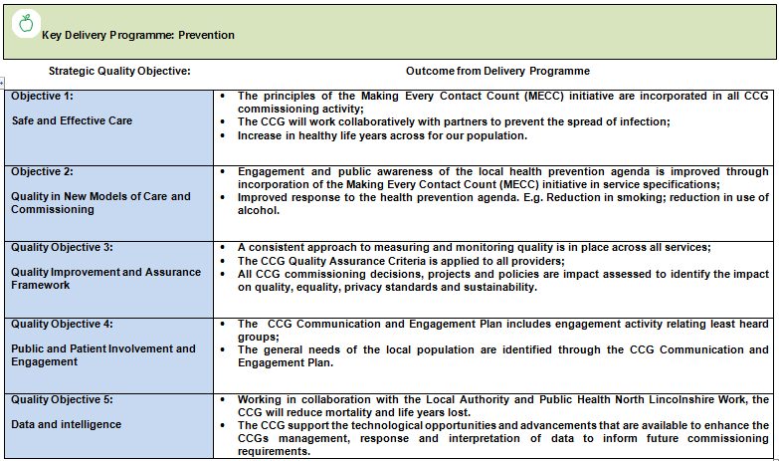
7. Key Delivery Programmes
DRAFT
15

Slide 14
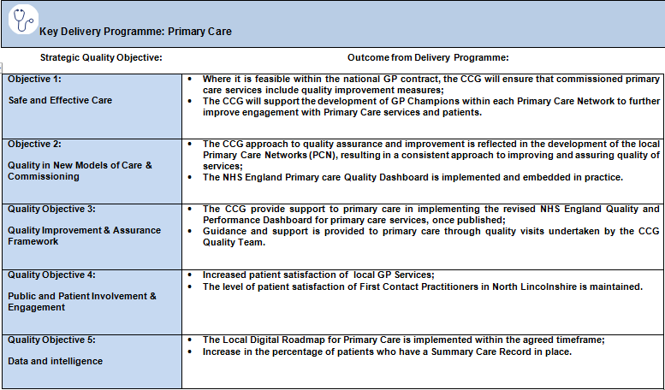
16

Slide 15
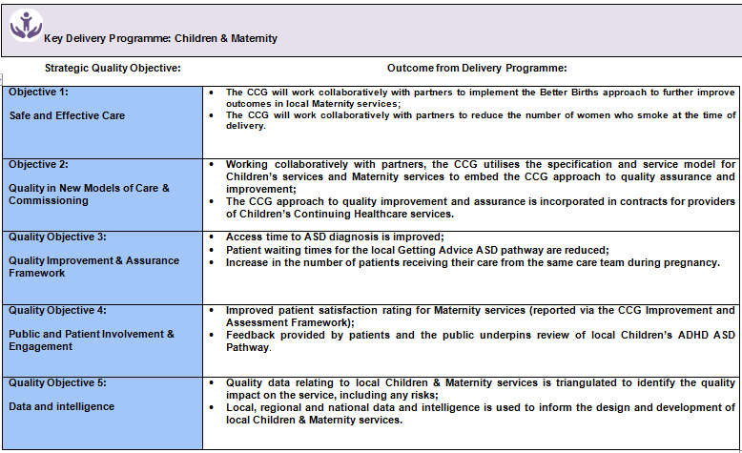
17

Slide 16
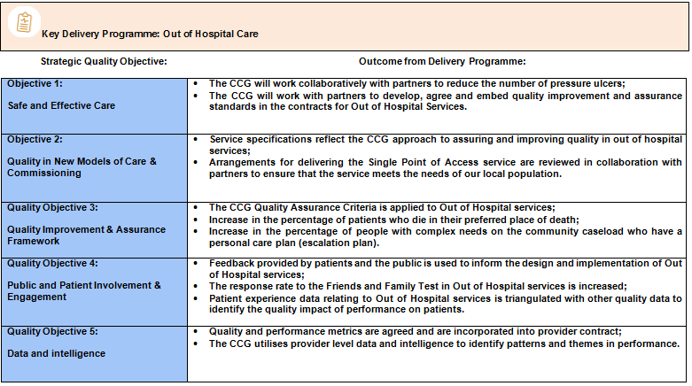
18

Slide 17
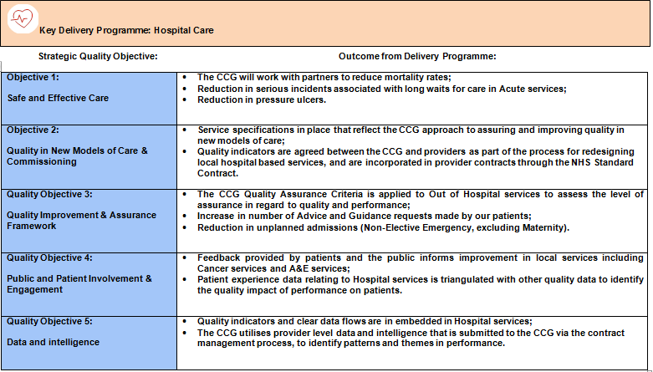
19

Slide 18
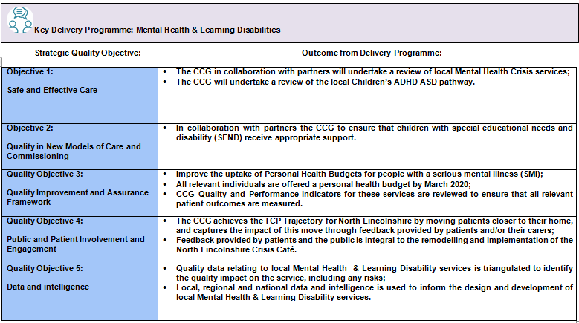
20

Slide 19
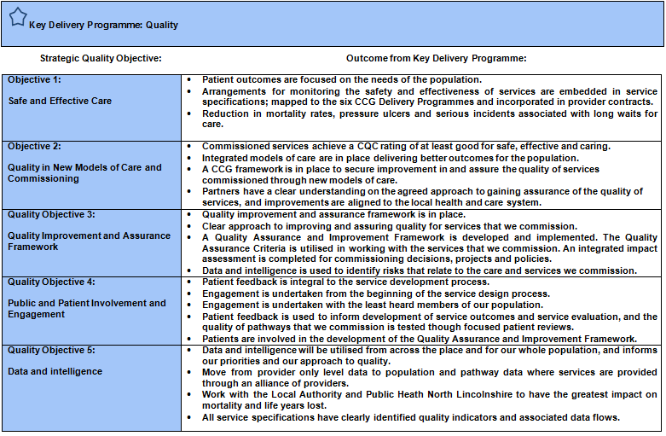
21

Slide 20
8. CCG Quality Strategy 2019 – 2024 Governance Structure
Planning and Commissioning Committee (P&CC)
Quality Performance and Finance Committee (QP&F)
Programme Delivery Group (PDG)
Provider Quality Contract Meetings
Governing Body
The Governing Body is responsible for approving and ensuring compliance with the strategy.
The quality of provider services reviewed by the QP&F.
Progress against CCG Delivery Programmes is overseen by the P&CC.
The quality impact of Delivery Programmes reviewed by the PDG.
Provider performance against quality standards reviewed via Quality Contract Meetings.
22

